Slide 1
Lecture 5 Subroutines and stack
Computing platforms
Novosibirsk State University University of Hertfordshire
D. Irtegov, A.Shafarenko
2018

Slide 2
Stack
Stack as a primitive (opaque type with predefined set of operations)
Primitive means that we have semantic of the operations
But do not know (or should not rely on) details of implementation.
So we can change implementation without changing the semantics
Two operations: push and pop
Push stores data in some [internal] storage
Pop retrieves them in LIFO (Last In First Out) order

Slide 3
Stack on CdM-8
SP register (we discussed it during CocoIDE demonstration)
Main memory pointed by SP register (*SP)
Push rn
((SP-1)→SP) then (rn → *SP)
Pop rn
(*SP → rn) then ((SP+1)→SP)
At CPU power on, SP==0
First push makes SP==255, so stack starts from the top of the RAM
Be careful!

Slide 4
How stack works

Slide 5
Be careful!
If you push too many times, you can overwrite your program!
If you pop more times than push, SP wraps over to 0 and you can overwrite your program again!
Commercial CPU (x86, ARM) have hardware protection against this
We will discuss it in Operating System course
And this protection is not 100% bulletproof (you can mess your stack if you really want to)
CdM-8, like most other 8-bit CPU, has no hardware protection (at least in basic configuration)

Slide 6
Wait, there is more!
Ldsa rn, offset
SP+offset → rn
Not in instruction-set.pdf (we’re working on this)
Addsp n
SP=SP+n
Ldsp rn, Stsp rn
Move SP to/from a GP register n

Slide 7
Subroutine call and return
Jsr [const]
SP-1→SP, then PC → *SP, then const → PC
In most modern CPUs this instruction is called Call
Jsr mnemonic comes from IBM 360
Rts
*SP → *PC, then SP+1→SP
Jsrr rn
SP-1→SP, then PC → *SP, then rn → PC
You can implement function pointers!

Slide 8
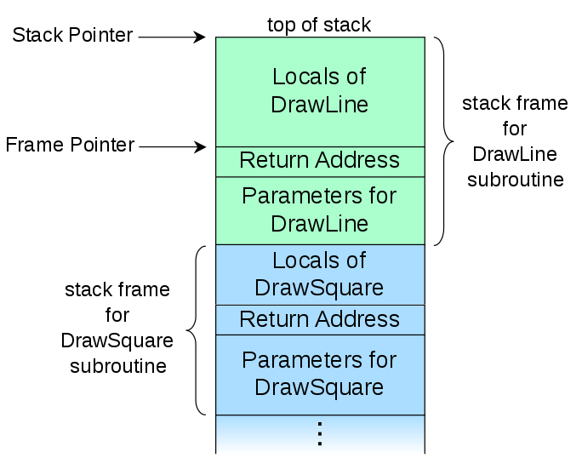
Subroutine activation record
Create a space for local variables
New space for every new call
Allows recursion
CdM-8 has no frame pointer
Caller push param to stack
Then jsr to callee
Then callee addsp frame size
And uses ldsa to access values

Slide 9
Special syntax for local variables (and structs!)
1 tplate foo
00: 2 dc "abcde"
05: 3 a: ds 13
12: 4 dc "this is it"
1c: 5 b: ds 7
23: 6
7 asect 0
8: main:
00: c9 05 9 ldsa r1,foo.a
02: ca 1c 10 ldsa r2,foo.b
04: cb 23 11 ldsa r3,foo._
….

Slide 10
What exactly tplate directive does?
A template is a named absolute section that
starts at 0,
does not allocate any memory
dc parameters are only placeholders
is accessible in the whole source file,
the section’s text can not be interrupted and continued later
Each label defined within a template is absolute and must be referenced using the prefix name.

Slide 11
Calling conventions
How to pass parameters
On registers?
Fast, but CdM-8 has too few registers
Cannot pass structures
On stack?
Relatively slow
Who cleans the stack after the call?
On CdM-8 it is hard for callee to clean the stack, but other CPU have means for that
Callee must know size of parameters to clean the stack (impossible in C)
How to save registers?
Clean protocol (callee must save all registers before touching them)
Dirty protocol (callee can change any register)
Hybrid protocol (some registers must be saved, some are not)

